Slide 1
Enriching RICH Data
Richelieu. Histoire du quartier
Ravinithesh (EPFL) Intern at INHA

Slide 2
Contents
Previous Status of the Project
Objective of the Internship
Work during Internship
Conclusion

Slide 3
Project state before start of internship
Notes:
Let’s see what was the end of Phase 1 of the project.

Slide 4
Previous Work
Data extraction from directories of addresses in Paris between 1839 and 1922
56 directories, which represents approximately 27,000 scanned pages.
OCR was performed on the segments to extract text in the form of Name, profession, Street, number per year (~4.5 million lines).
Notes:
Isabella and her team has taken up the duty to extract the data from the address directories (Bottins as we call them) for the years between 1839 and 1922. There were 56 directories in those 89 years which corresponded to 27,000 pages. This data was available on Gallica. They have downloaded and extract the data into a table format.

Slide 5
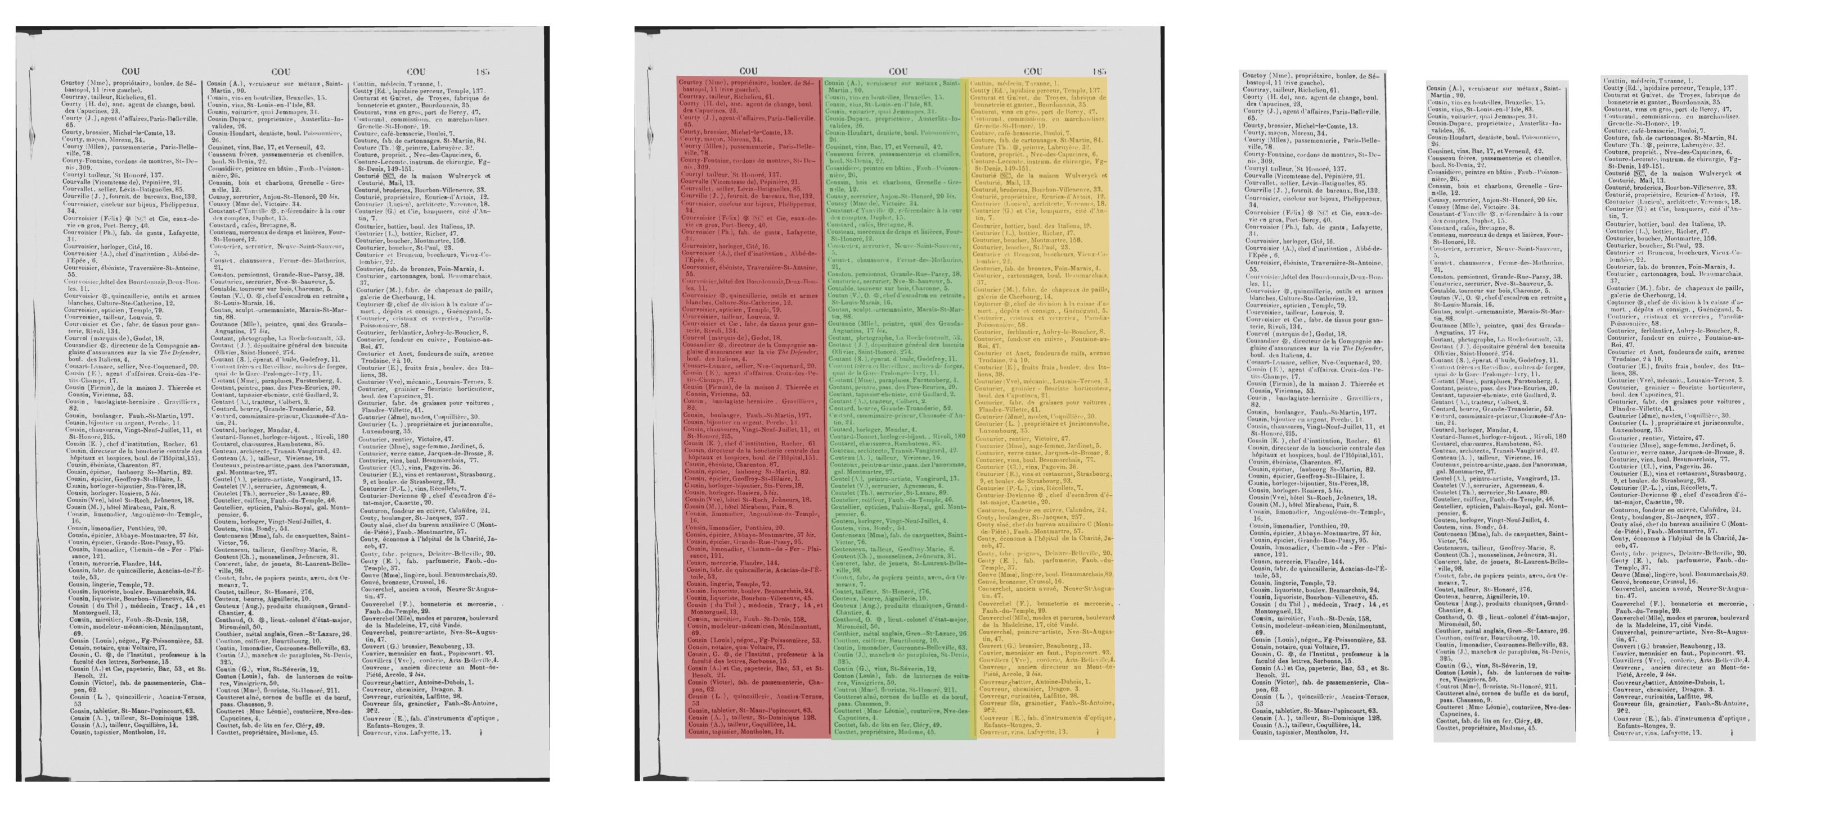

Slide 6
Notes:
First the page was scanned to obtain the text and then the text was separated in to a table resulting in nearly 4 million of lines for the entire Paris.

Slide 7
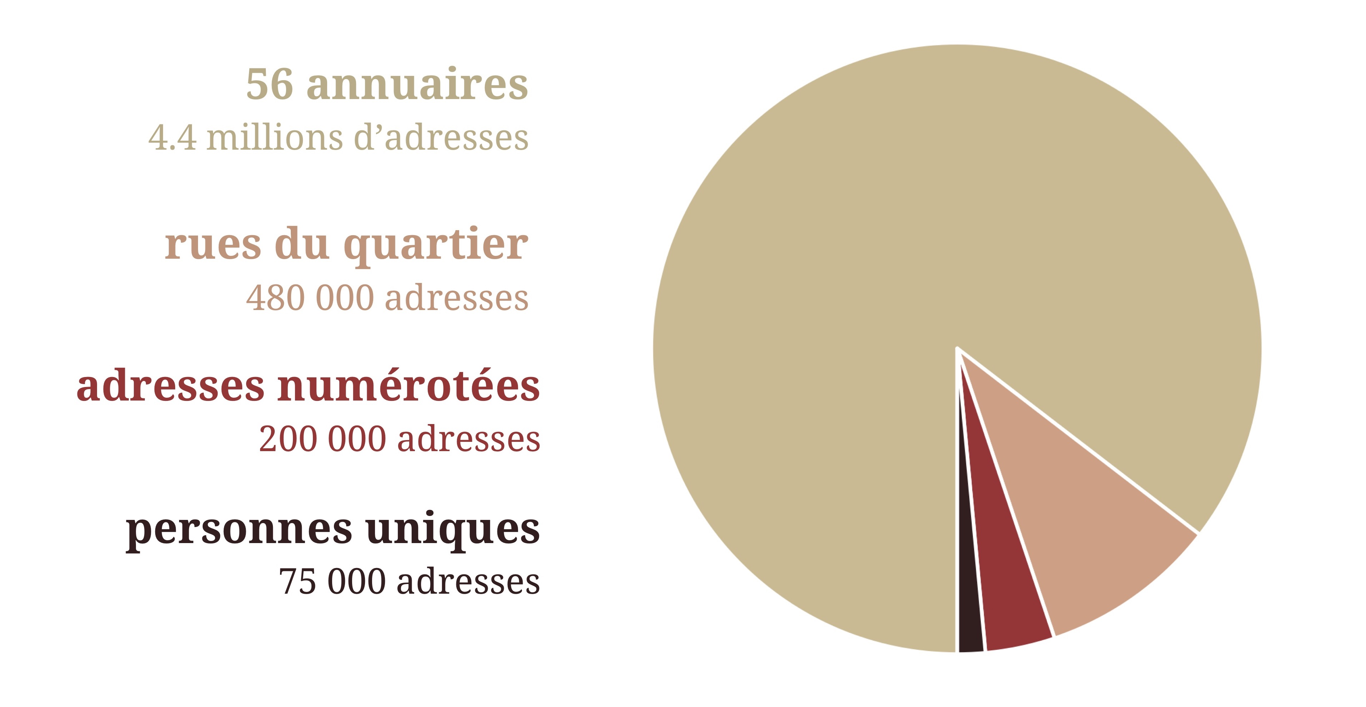
Summary of Phase 1
Notes:
A subset of data corresponding to Richelieu district was extracted from the above OCRized data.
Separated 200,000 address corresponding to Richelieu district and
Geo referenced the addresses by providing a latitude and longitude.
In summary, they scanned 56 directories, obtained 4.5 million addresses. Extracted 200,000 addresses representing 75,000 unique people in the Richelieu district from 1839 to 1922.

Slide 8
Summary of Phase 1
Remaining
The professions were not cleaned.
Hindering the ability to search for the people based on the profession.
Professions were shortened with the used of abbreviations like fabr., fab., propriét., commissionn., entrepr., ingén. etc.
Notes:
The un dealt part of the previous phase of the project was cleaning the professions across years. This will hinder us from searching for people based on profession.
At the same time, abbreviations were used to save space.

Slide 9
Internship
Notes:
Let’s see what was the end of Phase 1 of the project.

Slide 10
Objective
Normalization and alignment of data from directory extraction
Migration of the Directory data to a public data repository
Notes:
In continuation with previous phase, this internship was planned with 3 ideas. First, normalization and cleaning of the profession so that there appear similar across years. Secondly, make available the data of the 200,000 lines of data for Richelieu district with the cleaned professions and geo referencing to the public by publishing it to a data repository.

Slide 11
Work
Notes:
Now, I shall present you the work that I have performed during these months.

Slide 12
Tasks
Improve the data to enable text based search
Creating tags based on profession for each row of the data and using these tags to match the search keyword.
The tags shall overcome the spelling and matching errors and reduce the computation time
Publication of the data
Make available the dataset to public.

Slide 13
Tags Generation
Notes:
The first objective is cleaning the profession. Instead of cleaning the profession strings, the idea is create tags that are keywords that would represent the profession. The tags shall overcome the spelling and OCR errors and help in matching the professions across years. I shall talk about this with a set of examples.

Slide 14
Some Professions
hôtel et vins
vins fins
épicier
g. ¥premier présidant à la cour des comptes
fab. de châles et confections pour dames
hôtel del'ancien grand-cerf
rédact. en chef et propriét. du journal l’europe artistque
produits chimiques pour l'a. griculture
bole! et vins
{picier
fabr. de voitures
directeur de la boucherie centrale des hopitaux et hospices.civils de paris
fabr. d'éta lages et d'armures
c. ¥. général de division en retraite
Notes:
These are some of the professions extracted from the data set
In these few professions we have 5 issues
First is the appearance of the special characters in entries 4, 8, 9 and 14.
Second is the spelling mistakes 4 (for president), 7 (for artistic), 12 (for hospital)
Third, there are abbreviations in 5,7,11,13.
Fourth, some words are wrongly split. For example agriculture in 8 and etalages in 13.
Lastly, in 12 we can see that hospices and civil are combined into one word.
This part of the internship is about dealing with these challenges.

Slide 15
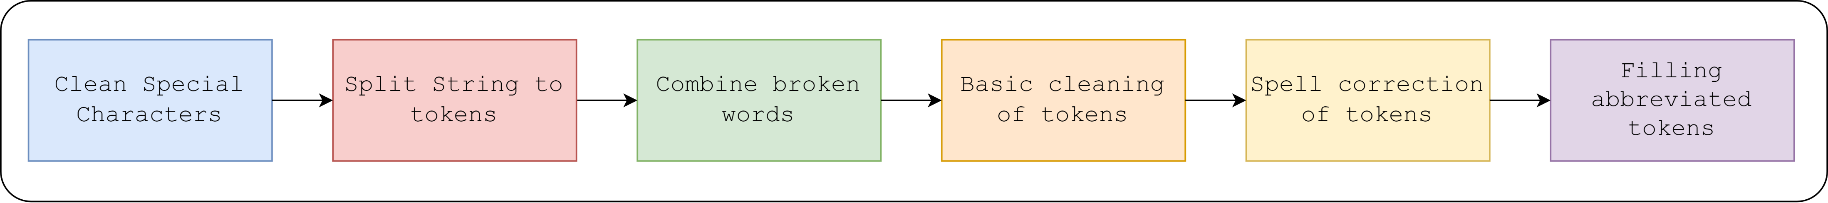
Pipeline
Notes:
The following pipeline has been developed to create tags for each profession that deal with the problems mentioned earlier. In the first Phase, the special characters are cleaned, then words that are split wrongly are merged. In the second step the strings that represent the profession are split into words. In the third phase, the words that are not correctly split during the OCR process are split and the full forms to the abbreviation shall be added.
The data of 4 million lines will be used and the at the end rows corresponding to Richelieu will be extracted, as they would provide more information of words usage in the directories.

Slide 16
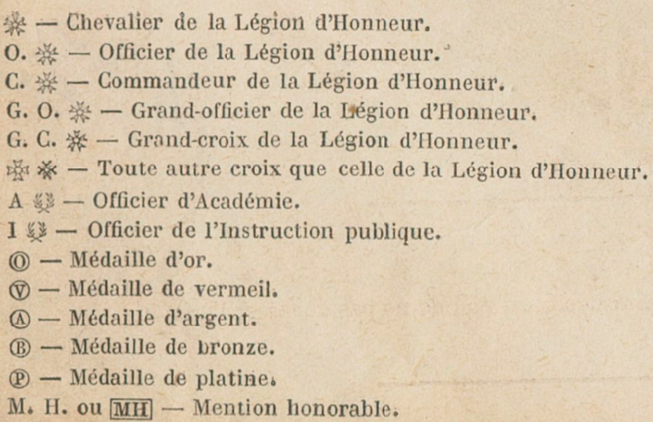
Dealing with Special Characters
., !, &, \, /, “, =, ^, #, `, $, *, %, _, £, (, ), @, +, :, ;, ?, <, >, [,], {, },|.
Example
g. ¥premier présidant à la cour des comptes
c. ¥. général de division en retraite
Changed to
premier présidant à la cour des comptes
général de division en retraite
Notes:
The characters that are not alphabets or digits are defined to be special characters for the scope of this project. Instead of removing the words with special characters, some corrections were made manually by looking at the bottin pages.
In the previous set of examples, consider these two examples. We see the Yen symbol in them and precede by a letter. Looking at bottin, we understand that this was used to indicate a title or an honor. Such common patterns are removed.

Slide 17
Combine wrongly split words
Words split into parts
Wrong interpretation of the text.
Low quality of the scan.
Text in multiple lines.
Examples
produits chimiques pour l'a. griculture
fabr. d'éta lages et d'armures
Changed to
produits chimiques pour l'agriculture
fabr. d'étalages et d'armures
Notes:
Now, for the second step. The words are split into parts because of wrong interpretation of the text, low quality of the scan and presence of text in multiple lines.
Considering our set of examples we join the words to form agriculture and etalage as the 4 words individually don’t appear frequently or in the dictionary.

Slide 18
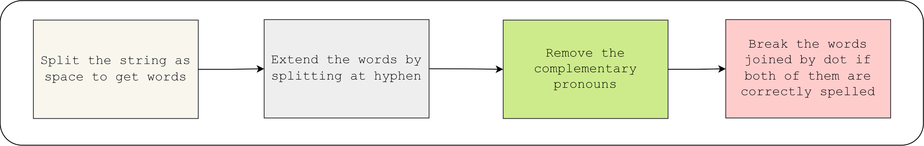
Keywords of Professions
Profession is described by a set of words.
The words contain keywords and stop/connecting words
Split the profession to capture the keywords and ignore the stop/connecting words.
Notes:
Now, we come to the third step. As we saw each profession is described by a set of words. these words contain keywords and stop/connecting words
While the keywords help identifying the profession, stop words help in reading the complete sentence and we do not necessarily need them. In this step we do that.
Let’s see the split on the previous set of examples
Pipeline
For each profession
Split the string at space and hyphen
Remove words that are in a stop words list provided by NLTK in French corpus.
Remove the articles joined with apostrophe.
Remove the tokens that have less than 3 alphabets.
On all tokens
If there is a token that is not in a dictionary with and without a dot at the end, replace the low frequent token with high frequent one.
Collect the tokens that are not in the dictionary and have the same normal form and replace them with the non normal version of the token that is most frequent.

Slide 19
Keywords of Professions
Profession String
Keywords
hôtel et vins
fins vins
épicier
premier présidant à la cour des comptes
fab. de châles et confections pour dames
hôtel del'ancien grand-cerf
rédact. en chef et propriét. du journal l’europe artistque
produits chimiques pour l'agriculture
bole! et vins
{picier
fabr. de voitures
directeur de la boucherie centrale des hopitaux et hospices.civils de paris
fabr. d'étalages et d'armures
général de division en retraite
[hôtel, vins]
[fins, vins]
[épicier]
[premier, présidant, cour, comptes]
[fab., châles, confections, dames]
[hôtel, ancien, grand, cerf
[rédact., chef, propriét., journal, europe, artistque]
[produits, chimiques, agriculture]
[bole!, vins]
[{picier]
[fabr., voitures]
[directeur, boucherie, centrale, hopitaux, hospices.civils, paris]
[fabr., étalages, armures]
[général, division, retraite]
Notes:
On the left we see the professions after the two steps. On the right we see the set of key words of different lengths for each profession. We removed the words connect the key words and also grammatical structure like l apostrophe.
This leaves us with a set of keywords that can help in searching the database. The slide shall show how does the split appear for the whole dataset.

Slide 20
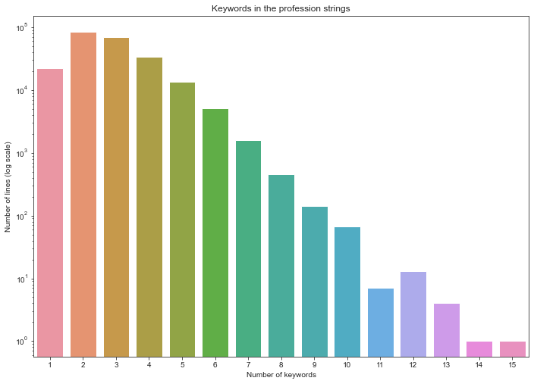
Keywords of Professions
4,394,013 lines of data
Notes:
At this stage, there are 232671 unique strings representing the 4 million lines of data extracted from the directories (after removing stop words)
In 232671 unique strings, the number of keywords after the split is shown on the graph on the right. The scale on y axis is log scale. We see that nearly 80,000 of the professions have two keywords like hotel and vins and 20, 000 of the professions have only one word describing them. Combining all the keywords from all the lines gives us 87,979 unique keywords. Lastly, out of these 88 thousand keywords only 18,000 are in the dictionary. Meaning that most of the remaining tokens are wrongly spelt, some of them are proper nouns like names, few have an old spelling or the words is currently not in use and few of them have the abbreviated form.

Slide 21
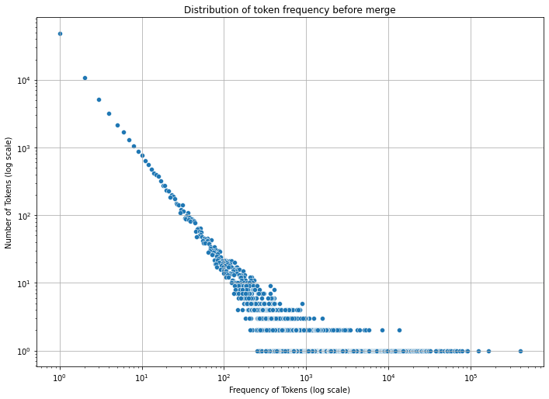
Keywords of Professions
4,394,013 lines of data
87,979 unique keywords
18,882 from 87,979 are in the dictionary (21.46%)
Notes:
At this stage, there are 232671 unique strings representing the 4 million lines of data extracted from the directories (after removing stop words)
In 232671 unique strings, the number of keywords after the split is shown on the graph on the right. The scale on y axis is log scale. We see that nearly 80,000 of the professions have two keywords like hotel and vins and 20, 000 of the professions have only one word describing them. Combining all the keywords from all the lines gives us 87,979 unique keywords. Lastly, out of these 88 thousand keywords only 18,000 are in the dictionary. Meaning that most of the remaining tokens are wrongly spelt, some of them are proper nouns like names, few have an old spelling or the words is currently not in use and few of them have the abbreviated form.

Slide 22
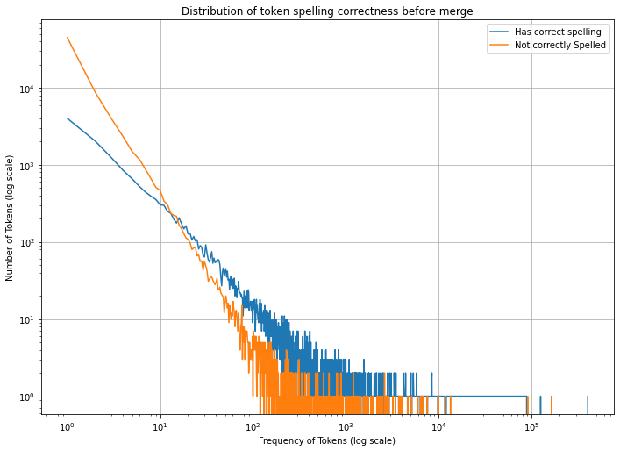
Frequency Distribution of Keywords
Most keywords appeared once
Spelling mistakes
Rare words
Unused language
Few Keywords appeared highly
Common professions
Represent significant part of the professions during 19th century.
Notes:
This plot shows the number of times a keyword has occurred across 4 million lines on the x axis. On the Y axis we see the number of keywords with the frequency on the X axis. We see that Most of the keywords have appeared only once and only few keywords have very high frequencies and the remaining few are in the middle.
The aim of cleaning will be to flatten the curve.

Slide 23
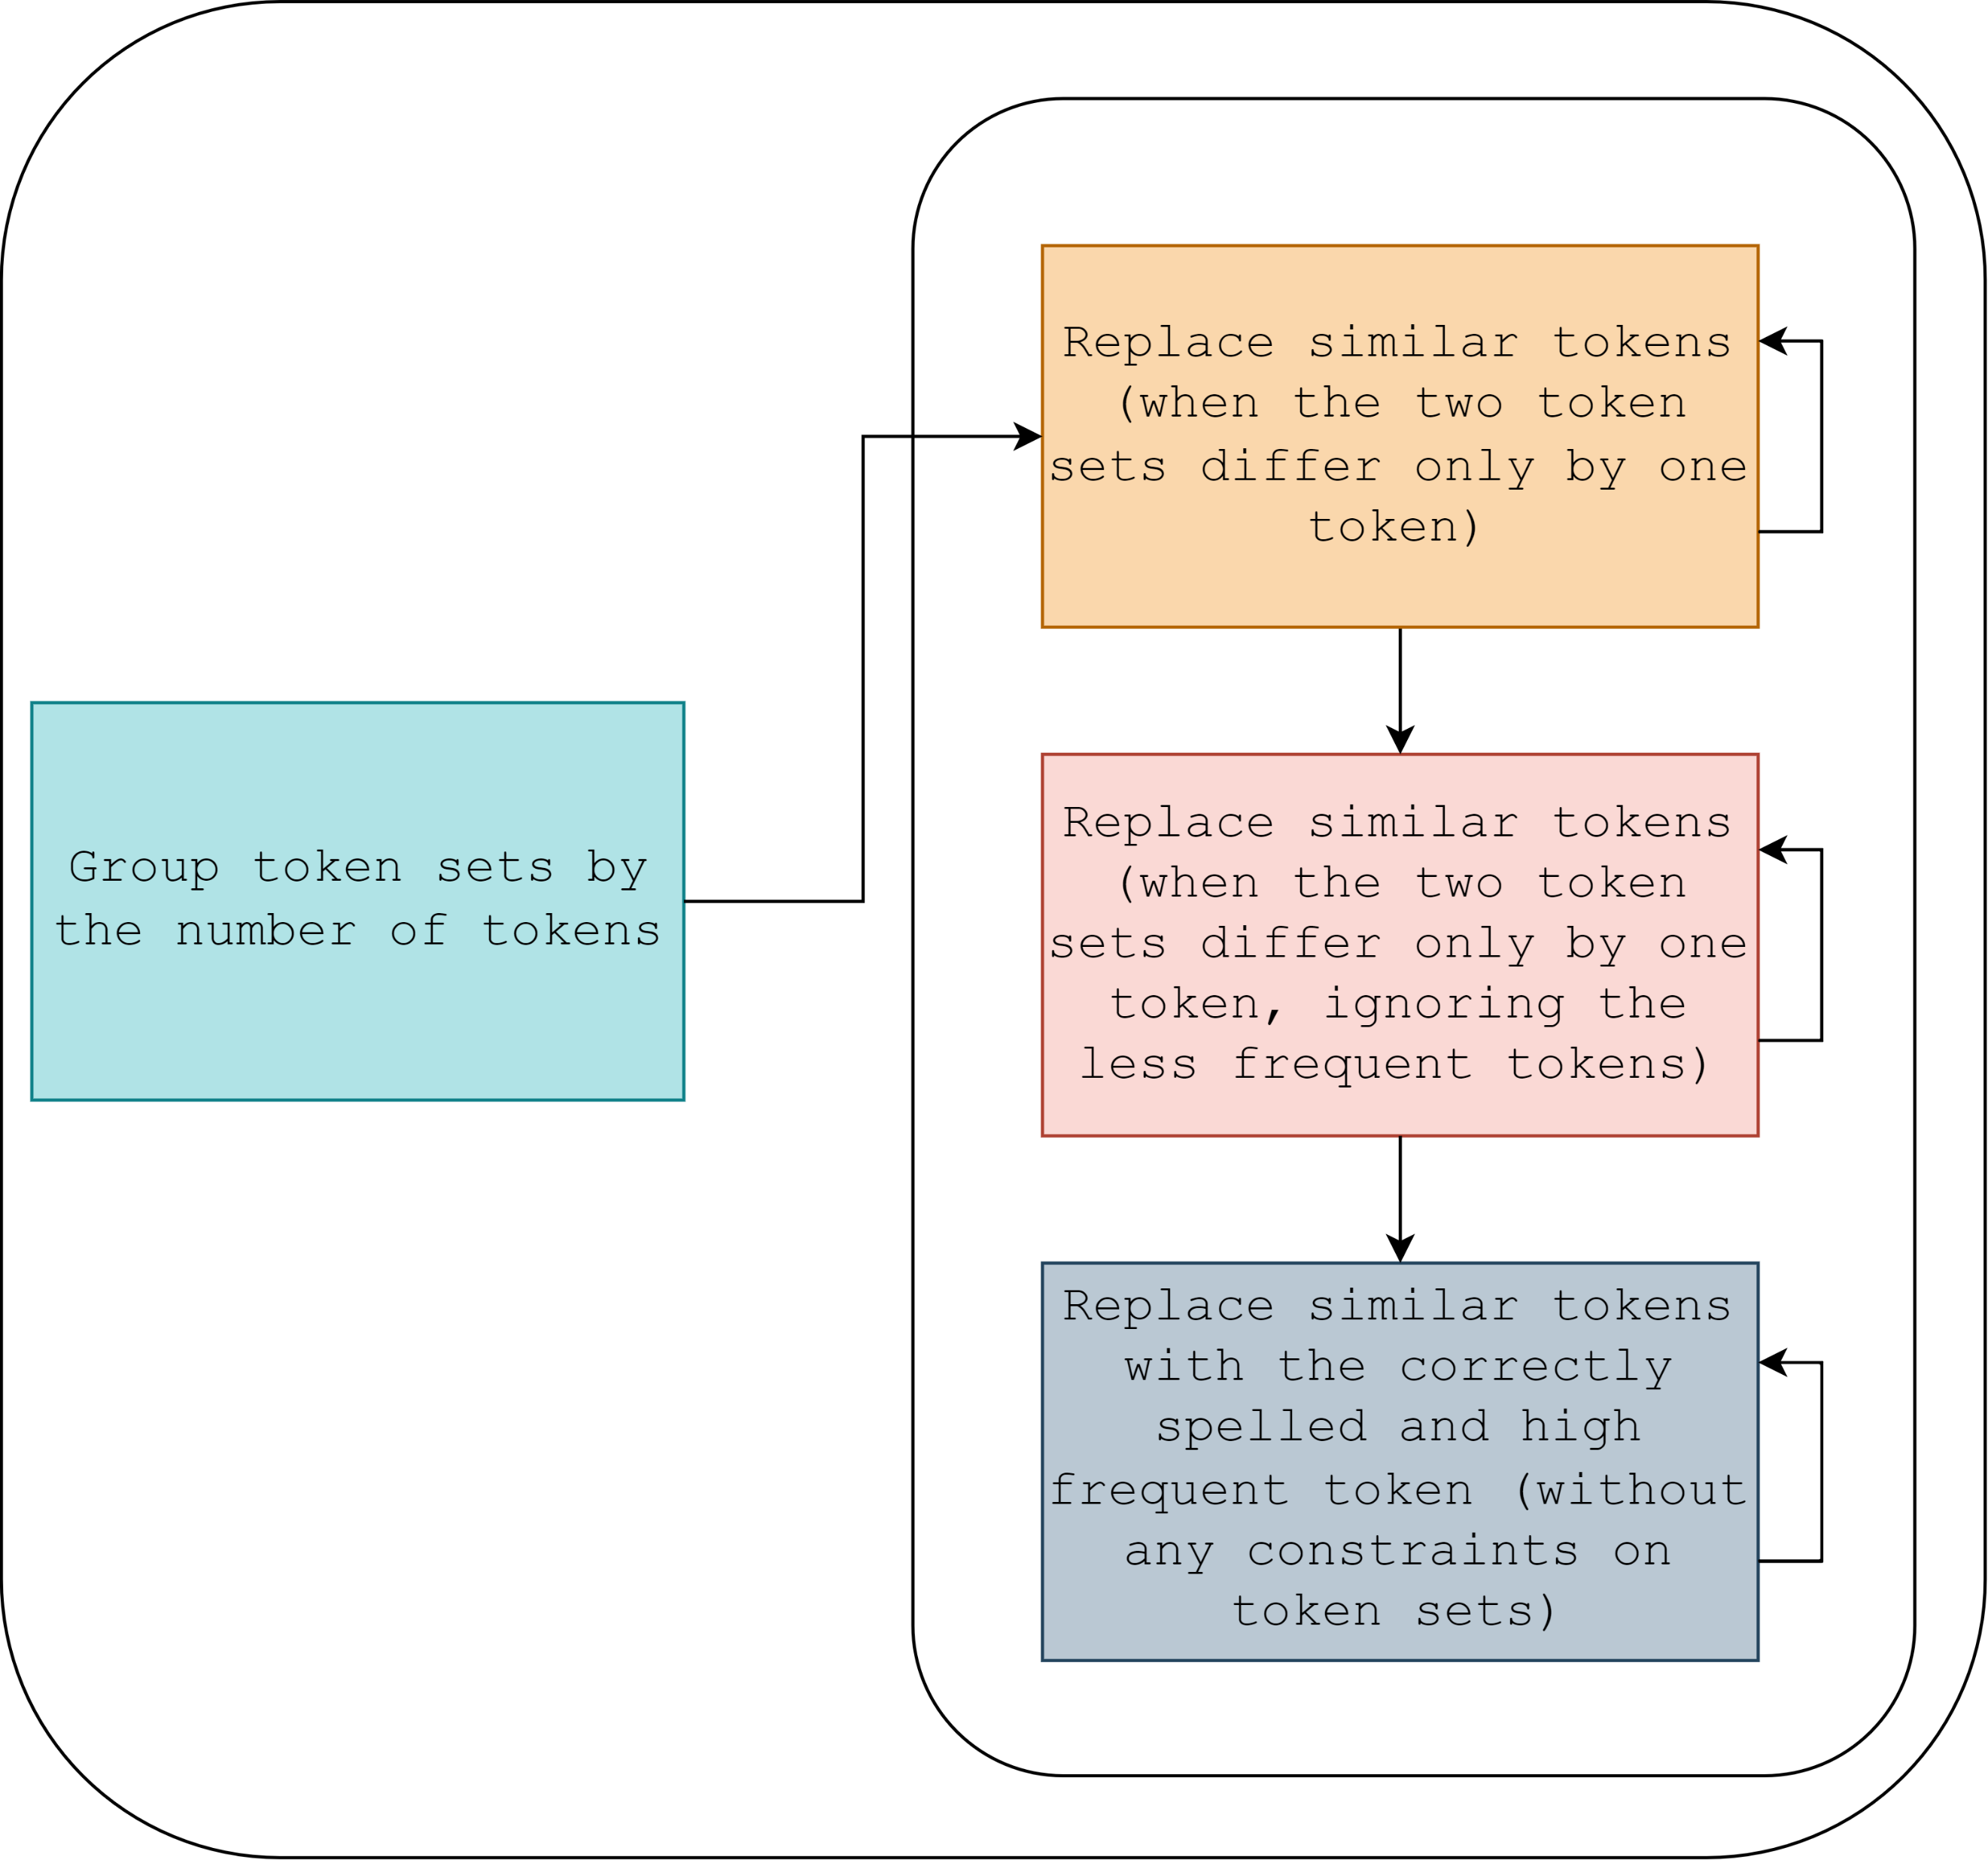
Refining the keywords
Reduce the number of unique key words such that most of them are in the dictionary.
Two steps
Cleaning the words based on context
Cleaning all the words together
Notes:
Among the 88 thousand tokens, most of have appeared only once and spelling mistakes. The aim is to refine this set of keywords.
In this second phase, the essence of cleaning these tokens is to bring the number of unique tokens to number of tokens in the dictionary
This cleaning is performed in two main steps. First, using the co occurrence of words to correct the keywords with wrong spellings. Then without using their cooccurrences to correct them.

Slide 24
Spell correction based on context
Example
For, bole! et vins, bole! and vins are keywords.
Correct bole!.
Might become boule.
Considering context with hôtel et vins, will set it to hôtel
The correction is made with high confidence.
Similarity is based on Levenshtein distance
minimum number of single-character edits (insertions, deletions or substitutions)
Example: Similarity between hôpitaux and hopitaux is 88%.
Notes:
What does cleaning with context mean? Simply replacing the close words in the unique keywords with a higher frequency token can reduce the number of mistakes, it could lead to faulty correction.
Consider the example of “bolel et vins”. Without context, bole! Could become boule or something else. But comparing with hotel et vin, 2 out of 3 words are same and the other words also appear similar. Thus this correction is made with high confidence and to the correct word.
To decide if two words are similar, we use a metric called levensthtein distance that tells minimum number of edits needed to convert one word to another. For example the similarity between hôpitaux and this wrong spelling is 88%.

Slide 25
Correcting all the keywords together
Merge similar words irrespective of context.
Similar words that are not in the dictionary are merged with close words in the dictionary.
Notes:
In the last step of correction, the same similarity between words is used to correct them but we do not check if they occur together elsewhere.

Slide 26
Keywords of Professions
Keywords
Keywords
[hôtel, vins]
[fins, vins]
[épicier]
[premier, présidant, cour, comptes]
[fab., châles, confections, dames]
[hôtel, ancien, grand, cerf
[rédact., chef, propriét., journal, europe, artistque]
[produits, chimiques, agriculture]
[bole!, vins]
[{picier]
[fabr., voitures]
[directeur, boucherie, centrale, hopitaux, hospices.civils, paris]
[fabr., étalages, armures]
[général, division, retraite]
[hôtel, vins]
[fins, vins]
[épicier]
[premier, président, cour, comptes]
[fab., châles, confections, dames]
[hôtel, ancien, grand, cerf
[rédact., chef, propriét., journal, europe, artistique]
[produits, chimiques, agriculture]
[hôtel, vins]
[épicier]
[fabr., voitures]
[directeur, boucherie, centrale, hôpitaux, hospices.civils, paris]
[fabr., étalages, armures]
[général, division retraite]
Notes:
At the stage, our keywords would look like this. The changes are underlined and highlighted.

Slide 27
Filling the Abbreviations
The users/researches shall not search based on the abbreviations.
Separate the words that are potentially abbreviation and manually they will be given full forms and those tokens shall be updated.
Example
fab., fabr., propriét.
Change to
Fabricant, propriétaire
Notes:
In the last step, we deal with abbrevations. From our set of examples and their keywords we see that some keywords are not complete.
The users/researches shall not search based on the abbreviations.
Thus we will manually they will be given full forms and those tokens shall be updated.
This step will be performed in the coming week.

Slide 28
Keywords of Professions
Keywords
Keywords
[hôtel, vins]
[fins, vins]
[épicier]
[premier, président, cour, comptes]
[fab., châles, confections, dames]
[hôtel, ancien, grand, cerf
[rédact., chef, propriét., journal, europe, artistique]
[produits, chimiques, agriculture]
[hôtel, vins]
[épicier]
[fabr., voitures]
[directeur, boucherie, centrale, hôpitaux, hospices, civils, paris]
[fabr., étalages, armures]
[général, division retraite]
[hôtel, vins]
[fins, vins]
[épicier]
[premier, président, cour, comptes]
[fabricant, châles, confections, dames]
[hôtel, ancien, grand, cerf
[rédacteur, chef, propriétaire, journal, europe, artistique]
[produits, chimiques, agriculture]
[hôtel, vins]
[épicier]
[fabricant, voitures]
[directeur, boucherie, centrale, hôpitaux, hospices, civils, paris]
[fabricant, étalages, armures]
[général, division retraite]
Notes:
At the stage, our keywords would look like this.

Slide 29
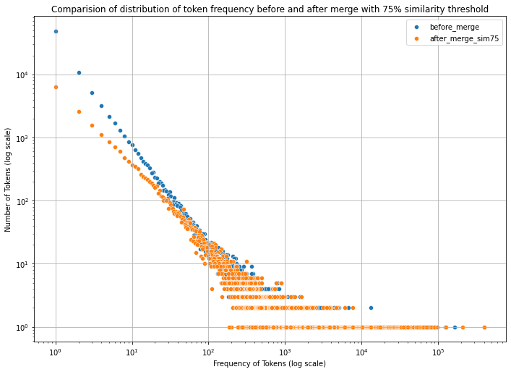
Cleaning all the words together
After the cleaning
24,314 unique keywords from 87,979
18,882 keywords in the dictionary (77.7%)
Notes:
After refining the keywords, there are 167,855 unique strings representing the 4 million lines of data and they contain 24,314 unique keywords and 18,882 of them are in the dictionary.
Let’s have a closer look at these unique keywords.

Slide 30
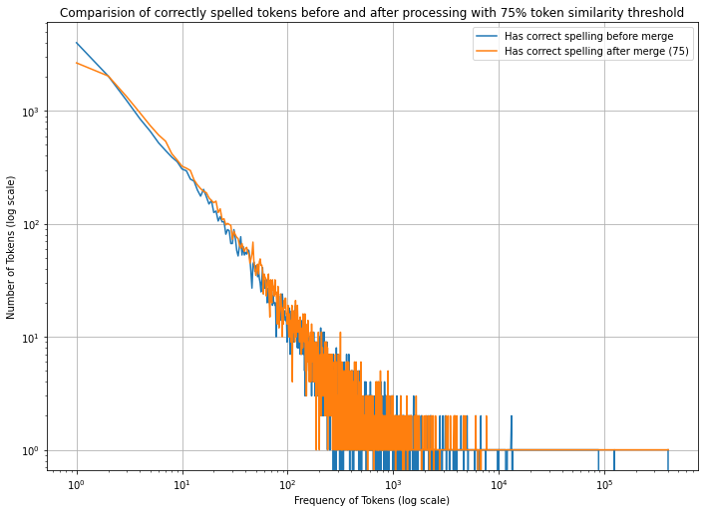
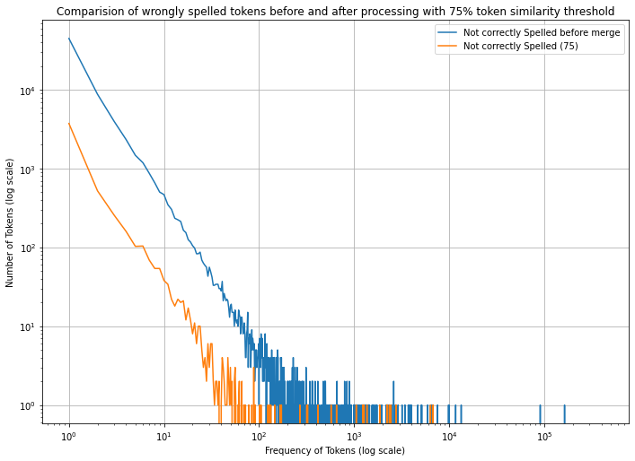
Correct spelling comparison (before and after merge)

Slide 31
Tags for Profession
After the above mentioned steps,
There are highly frequent keywords representing each line in 4 million lines.
The keywords corresponding to each profession will act as its keywords.
Notes:
After the above mentioned steps, we have keywords that are highly frequent and that represent the professions in the bottin

Slide 32
Data Publication
Notes:
The second part of the internship is to make the data extracted from the directories, available to others.

Slide 33
Data Publication
The data for the people in the Richelieu district in the 19th century with year, name, profession (as extracted from the directory), Street, Number and tags will be made available to the public.
The data will be made available in JSON format.
The data will be primarily hosted on GitHub and will be accompanied with a document that details the steps involved in cleaning the data.

Slide 34
Data Format
{
"rue name": {
"details": [
{
"rue number": {
"location": {
"geo coordinates": {
"latitude": "",
"longitude": ""
}
},
"people": {
"year": [
{
"Person Name": "",
"Profession": "",
"Tags": [],
"Related Data": {
"Multimedia URLs": [],
"Other URLs": []
},
"gallica link": ""
}
]
}
}
}
]
}
}

Slide 35
Future Directions

Slide 36
Semantic Clustering of Professions

Slide 37
Semantic Clustering of Professions
Different keywords for similar professions.
Today’s classification of professions is different.
Cannot search thematically
For example for fashion related or plumbing related.
Cluster the profession that use the words with same meaning
Manually annotate those cluster with themes
Could enable hierarchical organization of professions
Notes:
Now, we have key words that represent the professions. However, different set of keywords are used for similar kind of jobs or we cannot search jobs thematically like fashion related or plumbing related.
Thus, we can cluster the professions based on the meaning of the keywords and add themes to the clusters manually. This could help in hierarchical organization of the profession as well

Slide 38
Web Platform
Notes:
The second idea is to visualize the current dataset spatially and enable text based search.

Slide 39
Web Platform
Create a spatial view of the dataset
2 main components
Display people in the Richelieu district on a map.
Search bar to search for people based on the keywords.
Filters to select data based on year and/or street.
Such visualization can help in tracing the spatial growth of the district.
Notes:
The aim of the platform is to visualize this dataset spatially and provide option to search for people based on the jobs. Such platform can help in tracing the evolution of the district.

Slide 40
Conclusion

Slide 41
Conclusion
The internship time was used to enrich the dataset with tags that help in providing clean profession for people that were in the Richelieu district.
Two options for using the enhanced dataset.

Slide 42
Thank you

